Slide 1
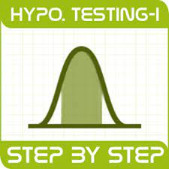
Hypothesis Testing
Azharuddin

Slide 2

But before diving in Hypothesis Testing

Slide 3
Data-Driven Decision making
Steps in Data-Driven Decision making:
Formulate a hypothesis
Find the right test
Execute the test
Make a decision

Slide 4
What is Hypothesis Testing ?
Hypothesis testing is like being a detective in the world of business data.
Imagine you have a hunch or a guess about something in your business –
Maybe you think that a new coffee blend is more popular than the old one,
Or that a new ad campaign is bringing in more customers.
Hypothesis testing is a way to check if your hunch is right.

Slide 5
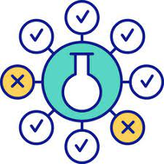
Here's how it works in simple steps:
The Hunch: You start with two opposing ideas. One is your hunch, called the "alternative hypothesis," and the other is the "null hypothesis," which is the boring idea that nothing has changed or that your hunch isn't true.
The Evidence: You collect data – like how many people bought the new coffee blend.
The Detective Work: You use math and statistics to analyze the data. This is like looking for clues to see if there's enough evidence to support your hunch.
The Verdict: After analysing, you decide if the clues (data) are strong enough to reject the boring idea (null hypothesis) and believe in your hunch (alternative hypothesis), or if you should stick with the idea that nothing's changed.
In business, this method helps you make decisions based on data, not just gut feelings. It's a way to be more confident that you're on the right track when you're trying to figure out what works best for your business.

Slide 6
Where would you use this?
Business will often find themselves in positions where they need to make decisions based on data.
Hypothesis testing provides a systematic way to make informed decisions that are backed by statistical evidence rather than intuition or guesswork.
Understanding Market Trends - It can understand and predict market trends
Marketing Strategies - Business can analyze whether a new advertising strategy leads to a significant increase in customer engagement or sales.
Investment Decisions - It can help assess the risk and return of potential investments.
Operational Efficiency - Businesses can improve operational efficiency. For example, they can test whether a new operational strategy reduces the time or cost of production.
Human Resources - It can be used to evaluate the effectiveness of new policies such as training and development initiatives or changes in the recruitment process.

Slide 7
That's fine but, how do we do this? Understanding Hypothesis Testing
Hypothesis testing is a systematic process used to make decisions about population parameters based on sample data.
The core idea is to evaluate two competing hypotheses:
The null hypothesis (H0) and the
Alternative hypothesis (Ha).
The null hypothesis (H0).typically represents a statement of no effect, no difference, or no relationship,
while the alternative hypothesis (Ha) posits the opposite.

Slide 8
1. Null Hypothesis (H0):
The null hypothesis states that there is no effect or difference, neutral or null attitude . It essentially represents the default assumption that no significant relationship or distinction exists between groups or variables.
Notation: H0: µ = µ0 or Ho: µx = µy
2. Alternative Hypothesis (H1 or Ha):
The alternative hypothesis, also known as the research hypothesis, opposes the null hypothesis. It reflects the researcher’s claim that there is a specific effect, relationship, or difference within the population.
Notation: H1: µ != µ0 H1: µ ≥ µ0 H1: µ < µ0
or
H1: µx != µy H1: µx ≥ µy H1: µx < µy

Slide 9
In a typical hypothesis test, researchers collect data from a sample, conduct statistical analysis, and compute a test statistic.
This test statistic is then compared to a critical value or p-value to decide if the null hypothesis should be rejected in favour of the alternative hypothesis.
The choice to accept or reject the null hypothesis is based on the chosen level of significance (alpha).
The outcome of a hypothesis test can lead to two conclusions:
Reject the null hypothesis: If the data provide sufficient evidence to conclude that the null hypothesis is unlikely to be true, researchers may reject it in favour of the alternative hypothesis.
Fail to reject the null hypothesis: If the data do not offer enough evidence to establish that the null hypothesis is false, researchers may choose not to reject it. This does not prove the null hypothesis’s truth but signifies a lack of evidence to reject it.

Slide 10
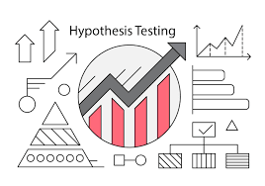
It is widely employed across diverse fields, including science, medicine, economics, and the social sciences, to validate research questions and hypotheses.
Hypothesis testing is an essential tool for data-
driven decision-making and drawing population-
based conclusions from samples.
Our detective starts by considering two scenarios.
The null hypothesis (H0) is the skeptical
sidekick, assuming that the new strategy
made no difference.
The alternate hypothesis (H1) is the optimistic partner, believing in the success of the strategy. They can't both be right, so the detective sets out to find which one to trust.

Slide 11
The Plot Twist: The p-value Method
With a magnifying glass in hand, the analyst collects evidence – data on sales before and after the strategy's launch. They're looking for clues that can either convict the null hypothesis of being false or let it go free.
The detective compares the evidence against critical values – benchmarks that help decide if the evidence is strong enough to reject the null hypothesis.
Sometimes, the detective uses a different tactic: the p-value method. This tells them the odds of finding the collected evidence if the null hypothesis were true.
The p value is used to indicate whether the results obtained after conducting a test are statistically significant or not. It also indicates the probability of making an error in rejecting or not rejecting the null hypothesis. This value is always a number between 0 and 1. The p value is compared to an alpha level, α or significance level. The alpha level can be defined as the acceptable risk of incorrectly rejecting the null hypothesis. The alpha level is usually chosen between 1% to 5%.

Slide 12

Formulate Hypotheses: Start with defining the null and alternative hypotheses, making clear the statement being tested.
Collect Data: Gather data through experimentation or sampling.
Choose a Significance Level: Set the level of significance (alpha), which represents the probability of making a Type I error (incorrectly rejecting a true null hypothesis).
Perform a Test: Calculate a test statistic (e.g., t-test, chi-squared test) based on the sample data and chosen statistical test.
Determine the P-value: Calculate the p-value, which represents the probability of observing the data if the null hypothesis is true.
Make a Decision: If the p-value is less than the significance level, reject the null hypothesis; otherwise, fail to reject it.
Draw Conclusions: Based on the decision, draw conclusions about the population parameter and its relationship to the sample data.

Slide 13
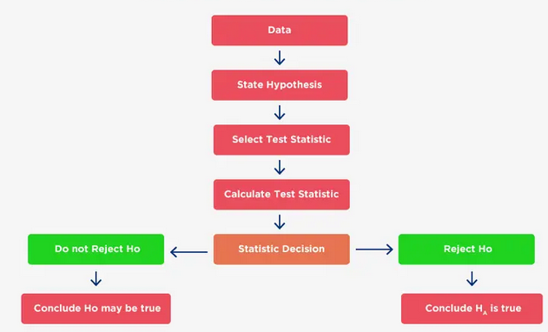

Slide 14
Example
For example:
Assume that a radio station selects the music it plays based on the assumption that the average age of its listening audience is 30 years.
To determine whether this assumption is valid, a hypothesis test could be conducted with the null hypothesis given as H₀: μ = 30 and the alternative hypothesis given as H_{a}: μ ≠ 30.
Based on a sample of individuals from the listening audience, the sample mean age, x̄, can be computed and used to determine whether there is sufficient statistical evidence to reject H₀.
Conceptually, a value of the sample mean that is “close” to 30 is consistent with the null hypothesis, while a value of the sample mean that is “not close” to 30 provides support for the alternative hypothesis.
What is considered “close” and “not close” is determined by using the sampling distribution of x̄.

Slide 15

Ideally, the hypothesis-testing procedure leads to the acceptance of H₀ when H₀ is true and the rejection of H₀ when H₀ is false.
Unfortunately, since hypothesis tests are based on sample information, the possibility of errors must be considered.
A concept known as the p-value provides a convenient basis for drawing conclusions in hypothesis-testing applications.
The p-value is a measure of how likely the sample results are, assuming the null hypothesis is true; the smaller the p-value, the less likely the sample results. If the p-value is less than α, the null hypothesis can be rejected; otherwise, the null hypothesis cannot be rejected.
The p-value is often called the observed level of significance for the test.

Slide 16
Types of Errors
Type I Error: Rejecting the null hypothesis when it is true (false positive).
Type II Error: Failing to reject the null hypothesis when it is false (false negative).
Even the best detectives can make mistakes.
In hypothesis testing, there are two main errors to watch out for.
A Type I error is like accusing an innocent suspect, while
A Type II error is like letting the guilty party walk free.
The detective must weigh the evidence carefully to avoid these blunders.
Hypothesis testing is the detective's method for making sense of the data-driven mysteries in the business world. It's a way to make informed decisions that are backed by solid evidence, not just hunches.

Slide 17
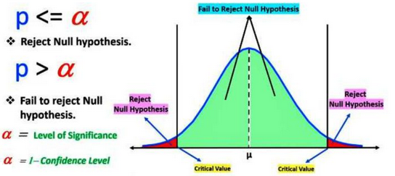
Hypothesis Testing Critical region
All sets of values that lead to rejecting the null hypothesis lie in the critical region. Furthermore, the value that separates the critical region from the non-critical region is known as the critical value.

